Slide 1
US National Debt

Slide 2
US Debt
h
Source: http://www.treasurydirect.gov

Slide 3
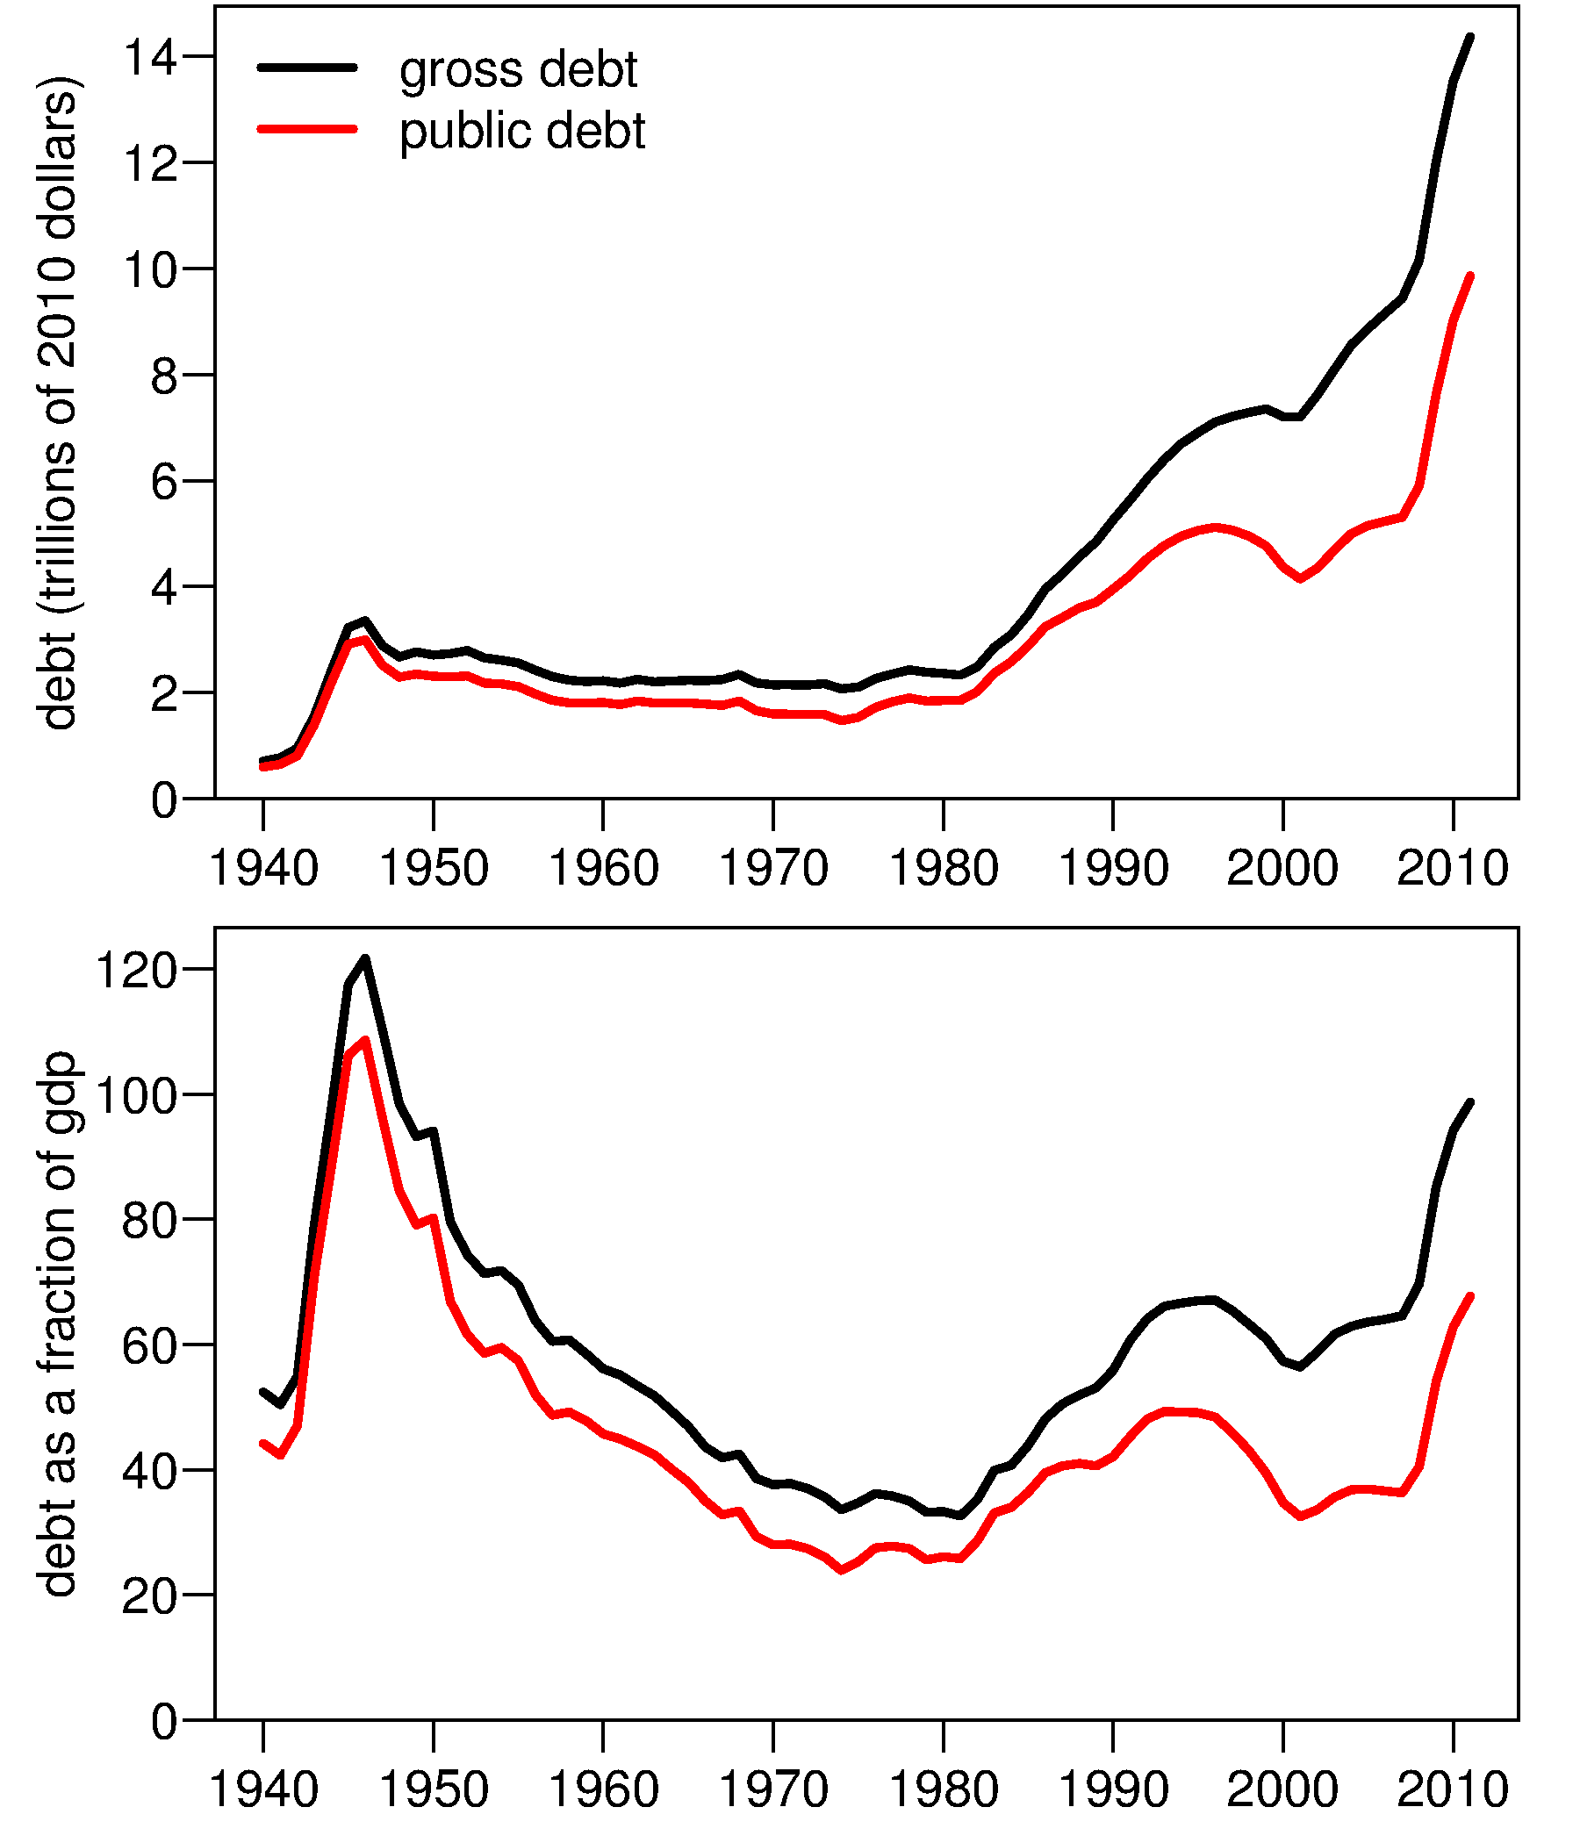
US Debt
Source: http://www.whitehouse.gov/omb/budget/Historicals

Slide 5
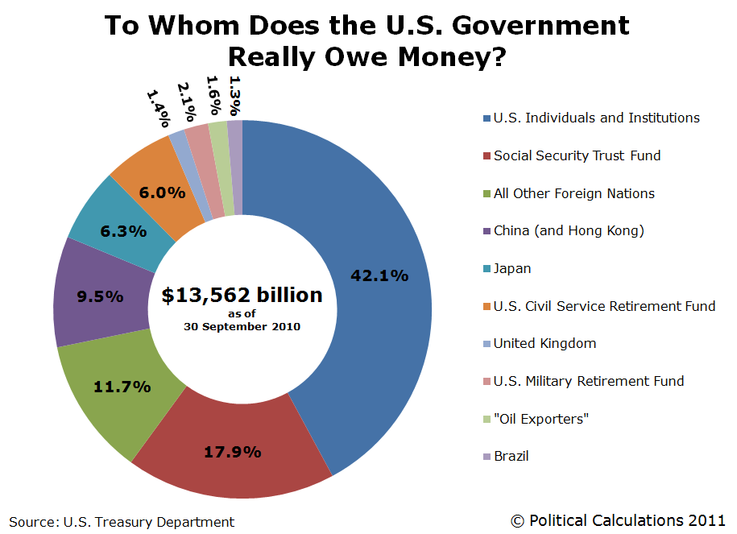
f
f

Slide 6
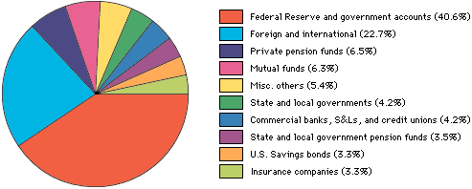
Who do we owe?

Slide 7
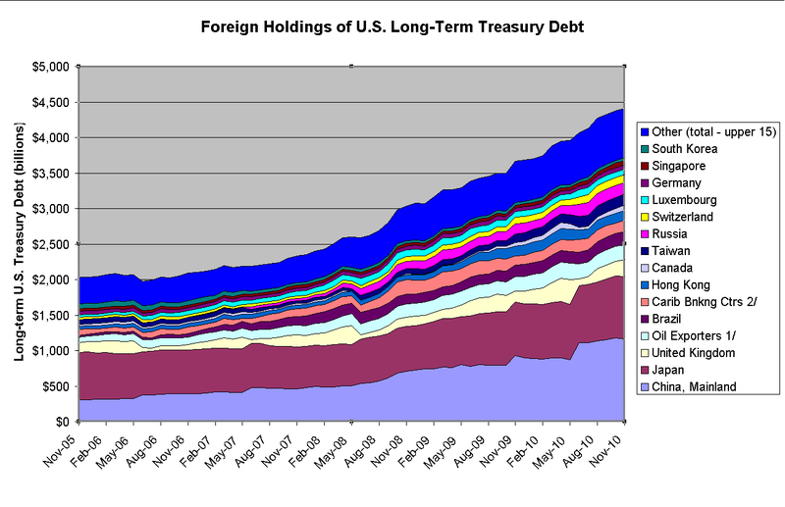
US Debt
g

Slide 8
US Debt
http://www.treasurydirect.gov/NP/BPDLogin?application=np

