Slide 1
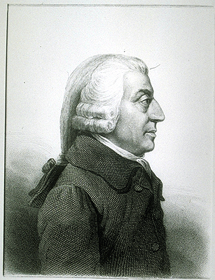
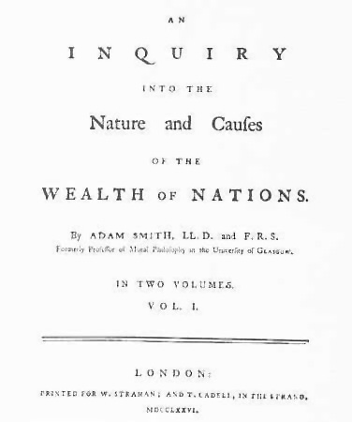
Adam Smith and The Wealth of Nations:
In Context

Slide 2
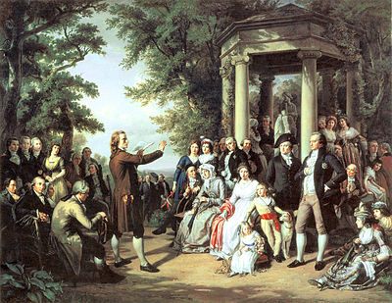
Age of Enlightenment
Reason-Abandonment of superstitions
Science and intellectual exchange
Empiricism
United States
Rights and liberty
Progress, tolerance,
Abuses of church and state
Egalitarian
Equality for all?
The Arts
Scientific Revolution

Slide 3
Adam Smith
Scottish Philosopher
Founder of Classical Economics
Mercantilism
Mineral Wealth and Land
Hoarding metals
Free trade makes everyone better off
Saw wealth in all goods and services
Theory of Moral Sentiments
Sympathy moderates our behaviors

Slide 4
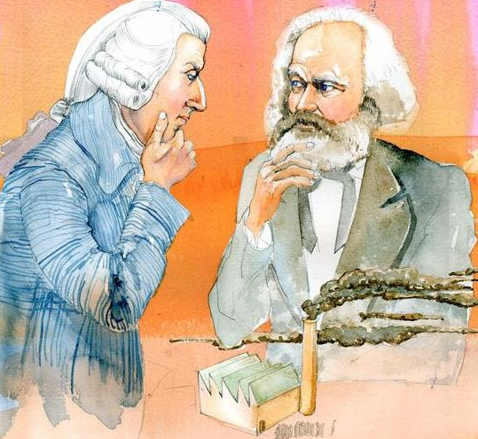
Adam Smith-Socialist?
Government
should subsidize education
Build infrastructure
A living wage?!
WTF-a progressive tax rate?
Each pays according to their income
The market is not the key to solving all problems!
Spread the wealth!

Slide 5
Theory of Moral Sentiments
Morality informs the economy
Egalitarian economy
Exchange of goods and services makes both better off
Minimum-do no harm
Try to do good!
Prudence, justice, beneficence and self-command

Slide 6
Shortcomings
Growth is the end not the means
Egalitarian
Anti large corporation
Everyone on an equal footing
No class domination
Greed overrides morality
Concentration of wealth
Information as a commodity/advantage
Pre-industrial revolution

Slide 7
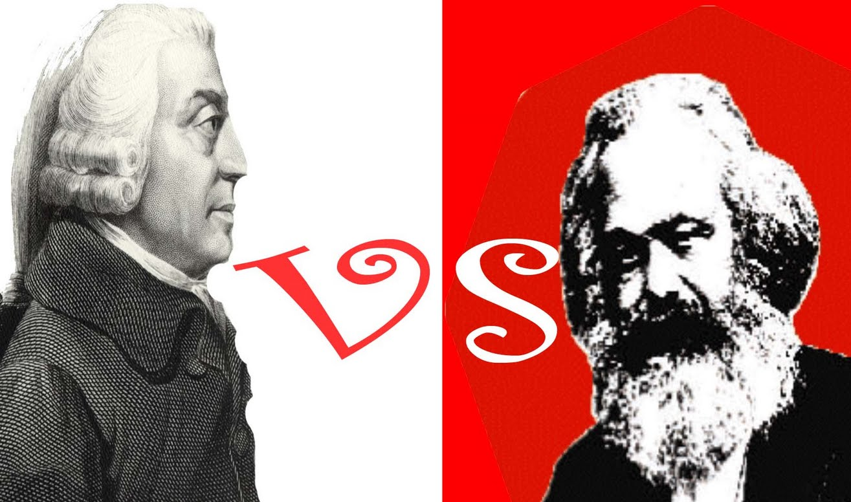
Both Classical Economists
Advantage-Marx
Industrial Revolution and its effects
Great poverty and concentration of wealth-not egalitarian-class oppression
Owners benefited while workers lost/suffered
Smith-producers isolated Marx-everyone connected
Alienation
Labor Theory of Value
Theory of Surplus Value
WON and Capital are complementary and both have flaws

