Slide 1

Changes to the Global Value of Ecosystem Services:
A Market Failure?
Dr. Paul C. Sutton
Department of Geography & Environment
University of Denver
-and-
Head of Discipline
Environmental & Geospatial Sciences
University of South Australia
1

Slide 2
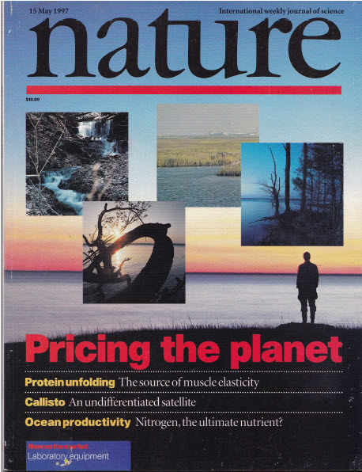
Some ES Valuation Background
In 1997 we published a paper titled:
The Value of the World’s
Ecosystems and Natural Capital
Sadly, it ended up on the cover of Nature with the catch phrase “Pricing the Planet” ☺
The gist of this paper stated that the global value of ecosystem services was roughly
$ 33 Trillion / Year
This was at a time when Global Gross National Product was roughly
$ 18 Trillion / Year

Slide 3
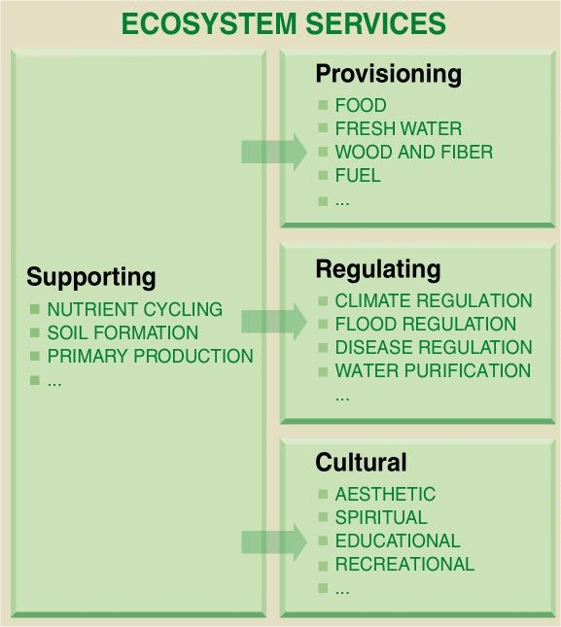
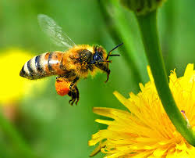
What are Ecosystem Services?
The benefits human beings derive from functioning ecosystems
3

Slide 4
Criticism of the 1997 Nature Paper
1) You simply underestimated infinity.
2) This is a commodification of nature that is a monumental act of hubris. You are simply trying to save the neo-classical economic paradigm by fixing an externality.
3) The intention of this research is
“Betting against Human Ingenuity”.
4) The methods are flawed and therefore the estimated values are wrong.
(Contingent Valuation, Aspatial, etc.)
4

Slide 5
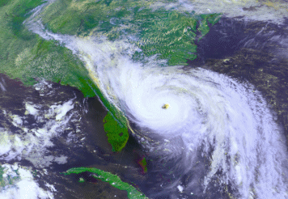
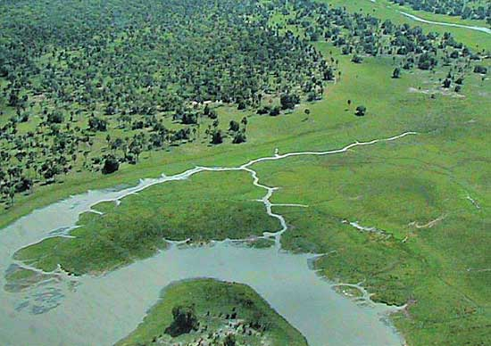
Economic Valuation of an Ecosystem Service: Storm protection services provided by coastal wetlands
‘Coastal wetlands reduce the damaging effects of hurricanes
on coastal communities by absorbing storm energy in
ways that neither solid land nor open water can.’ *
(Simpson and Riehl 1981).
What is the dollar value of the ‘reduced damage’?
What DATA does one need to answer this question?

Slide 6
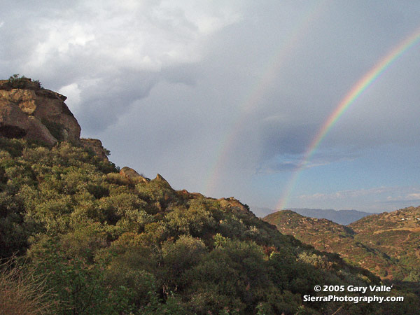
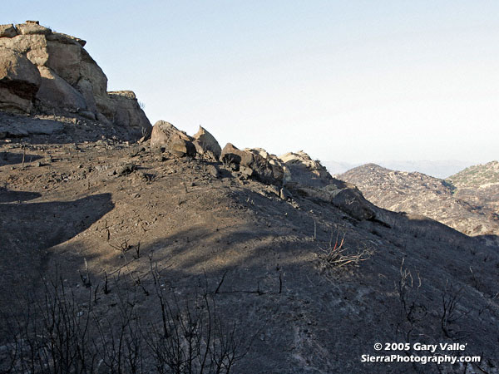
‘Geography’ or ‘Why Space Matters?’:
Spatially Explicit Valuation of Ecosystem Services
Before and After photos northeast of Sage Ranch, Topanga Fire, California
Forests and other vegetated landcover provide an ecosystem service in the form of soil retention, or, mitigation of soil erosion. (that is reduced by fire)
Q1: How might ‘where’ this service is provided influence the ‘value’ of the service provided?
Q2: How might ‘the size of the burned patch’ influence the ‘value’ of the service provided?

Slide 7
The Data Story for Valuation of Storm Protection from Coastal Wetlands…
1) Table of all Hurricanes that hit the U.S. since 1980 w/ Name, Year, $ Damage, # Dead, etc. ...
2) Shapefile of all the Hurricane Tracks since 1980 with windspeed, Category, Pressure, Temp
3) Population and Nighttime Imagery to obtain ‘people in swath’ and ‘GDP in swath’ (modeled)
4) LandCover (~30 Meter resolution - NLCD) to obtain ‘Wetlands’ information

Slide 8
The Damage Table (N = 34 Hurricanes)
Data Source: www.em-dat.net/index.htm

Slide 9
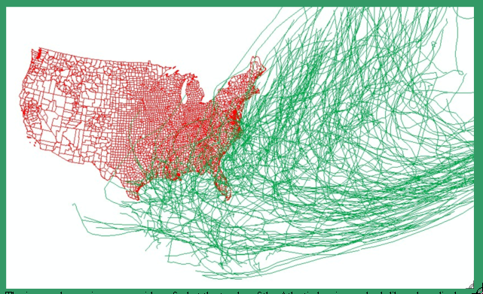
The Storm Tracks (N = ~100)
The Flying Spaghetti Monster ☺
Note:
Each Storm Track consists of smaller sections Which have
Category, Windspeed, Temp & Pressure Attributes
The image above gives one an idea of what the tracks of the Atlantic hurricanes look like when displayed In a Geographic Information System. These are represented as lines and had to be buffered to a width That reasonably approximates the damaging swath of a hurricane. We chose a swath width of 100km. (Data Source: www.grid.unep.ch/data/gnv199.php

Slide 10
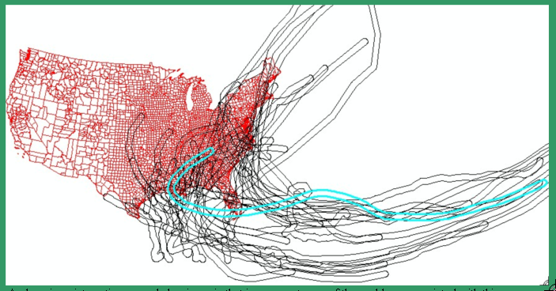
Buffer Existing Storms to 100 km (50 km per side) and Match to Damage Table (N=34)
Hurricane Andrew 1992
Andrew is an interesting example hurricane in that is represents one of the problems associated with this Analysis. Andrew did most of its damage during its first landfall in Florida. However, it went into the gulf of Mexico and struck the gulf coast later in its path.

Slide 11
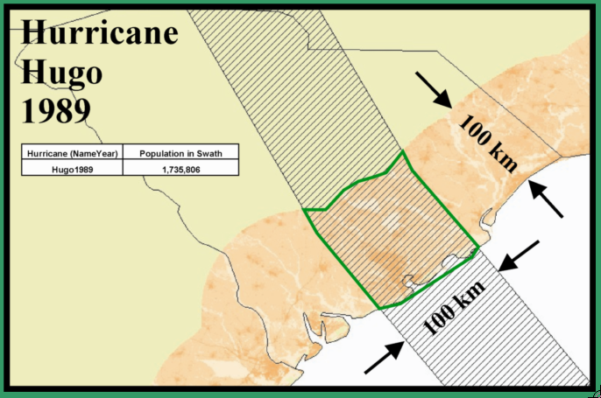
Fleshing out the Table: 1) Population in Swath
This image depicts
the swath of Hurricane
Hugo (1989) as it hit
South Carolina. The
shaded pink area is the
population density
masked to only those
Areas within 100 km Of
the coast. The zone of
intersection of the
swath of the hurricane and the
Population density on the
coast is roughly demarcated
by the green polygon.

Slide 12
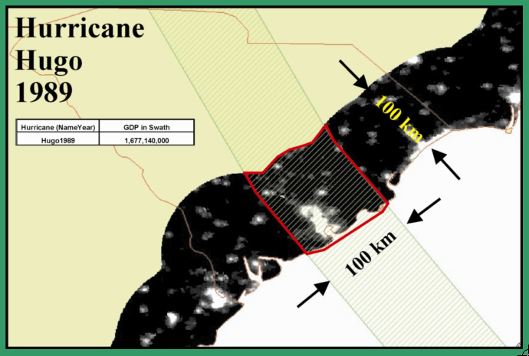
Fleshing out the Table: 2) GDP in Swath
Here, a disaggregated model of economic activity derived from nighttime imagery is overlaid with hurricane swath to get $ of GDP in swath.

Slide 13
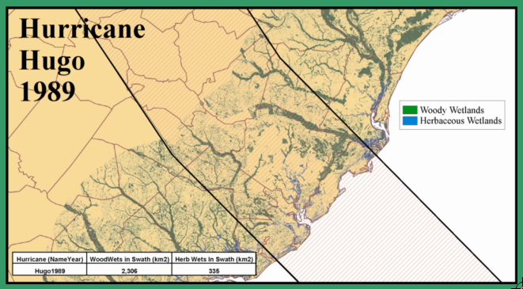
Fleshing out the table: 3) Wetlands in Swath

Slide 14
Regression Analysis ln (TD_{i} /GDP_{i})= a + b₁ ln(g_{i}) + b₂ ln(w_{i}) + u_{i}
TD_{i} = total damages from storm i (in constant 2004 $US);
GDP_{i} = Gross Domestic Product in the swath of storm i (in constant 2004 $US). The swath was considered to be 100 km wide by 100 km inland.
g_{i} = maximum wind speed of storm i
w_{i} = area of herbaceous wetlands
u_{i} = error
Regression Parameters
R² = 0.60
Observed vs. predicted relative damages (TD/GDP)
for each of the hurricanes used in the analysis.

Slide 15
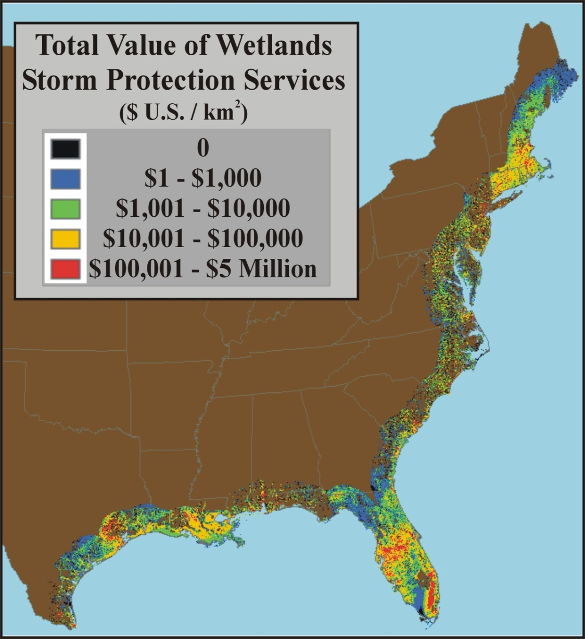
The Aggregate Conclusion
Mean Value of Coastal wetlands for storm protection:
$33,000/ha/year
Coastal wetlands in the U.S. were estimated to currently provide
$23 Billion/year
in storm protection services.
Note: All TSA activity costs 8.1 Billion per year (2012)

Slide 16
Increased interest in Ecosystem Services and their valuation
The aforementioned study of the value of the storm protection services provided by coastal wetlands was only one of literally thousands of peer reviewed books and journal articles that have been published on the valuation of ecosystem services since 1997.
There is now a journal titled: Ecosystem Services http://www.journals.elsevier.com/ecosystem-services/
The Millenium Ecosystem Assessment (MEA)
The TEEB initiative (The Economics of Ecosystems and Biodiversity)

Slide 17
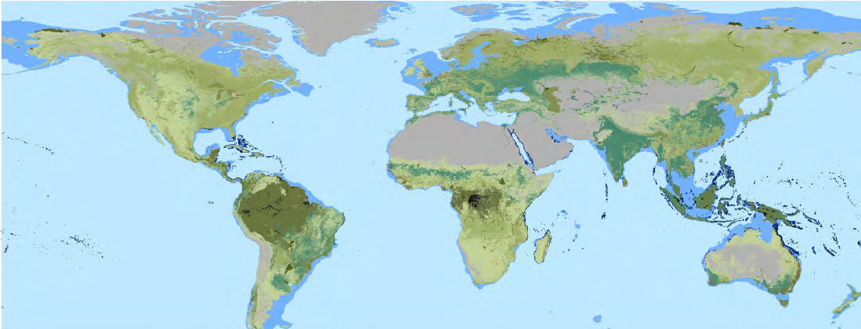
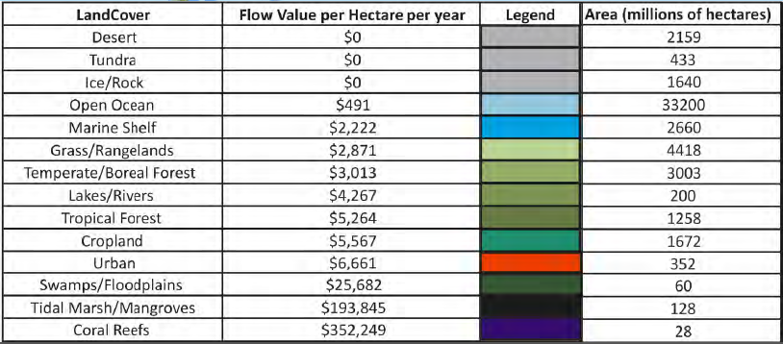
The 2011 Update to the 1997 Paper
The world is changing.
Land cover is changing.
ES Values have changed.
Our updated estimate of the Economic
Value of the world’s Ecosystem Services
are still signifcantly larger than the
world’s Market Economy.
2011
Gross World Product ~ $85 Trillion
Economic Value of
World’s Eco-Services ~$125 Trillion
Article in Global Environmental Change:
Changes in the global value of ecosystem services
Robert Costanza, Ph.D.; Rudolph de Groot, Ph.D.;
Paul C Sutton, Ph.D.; Sander van der Ploeg, Ph.D.;
Sharolyn Anderson, Ph.D.; Ida Kubiszewski, Ph.D.;
Stephen Farber, Ph.D.; R. Kerry Turner, Ph.D.
17

Slide 18
The Summarizing Table

Slide 19
Changes in the Global Value of Ecosystem Services
New Total Global Value for Ecosystem Services: $125 Trillion / year
Currently Global GDP is
$ 85 Trillion
Losses since 1997 amount to a reduced annual flow of $20.2 Trillion / year

Slide 20
Is this a market failure?
Ecosystem services can be regarded as:
  Public Goods in and of themselves.
  Suffering from both positive and negative externalities.
  Common Property.
  Having unclear property rights.
In addition, the economic value of Ecosystem Services are arguably twice as large as the market economy.
This is a massive market failure.
Econ 101 lesson coming up . . . .

Slide 21
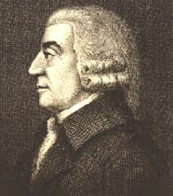
Adam Smith, Free Markets, and Neo-Liberal Ideology
‘Greed is Good.’
People acting in their own self interest naturally and without intention serve societies interests optimally.
“By preferring the support of domestic to that of foreign industry, he intends only his own security; and by directing that industry in such a manner as its produce may be of the greatest value, he intends only his own gain, and he is in this, as in many other cases, led by an invisible hand to promote an end which was no part of his intention. Nor is it always the worse for the society that it was not part of it. By pursuing his own interest he frequently promotes that of the society more effectually than when he really intends to promote it. I have never known much good done by those who affected to trade for the public good. It is an affectation, indeed, not very common among merchants, and very few words need be employed in dissuading them from it.”
Adam Smith
The Wealth of Nations
21

Slide 22

The Most Dangerous Myth?
How many
Economists does it
take to screw
in a lightbulb?
22

Slide 23
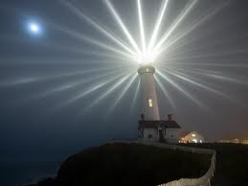
Free Markets will not . . . .
Build a lighthouse or a weather satellite
Create and sustain a judicial system
Invest enough in basic research
Enforce property rights fairly
Provide public education
Find a hole in the ozone layer
Clean up an oil spill
8) Create a commonwealth
“Climate change is the greatest market failure the
world has ever seen, and it interacts with other
market imperfections.”
2006 Stern Report
on the Economics of Climate Change
23

Slide 24
Market Failures Matter
Monopolies
- A monopolist will overcharge and under produce
- This is why we have government regulated utilities
Public Goods
- Non-Rival & Non-Excludable in consumption
- Fresh air, knowledge, national defence, street lighting
Common Property
- Garrett Hardin’s ‘Tragedy of the commons’
Externalities
- Both Positive and Negative can be problematic
- Pollution and Tragedy of the Condos

Slide 25
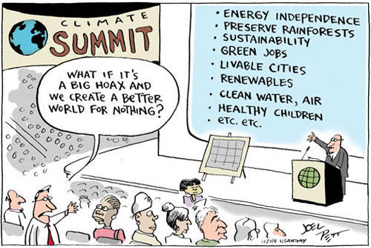
Is Climate Change a Market Failure?
25

Slide 26
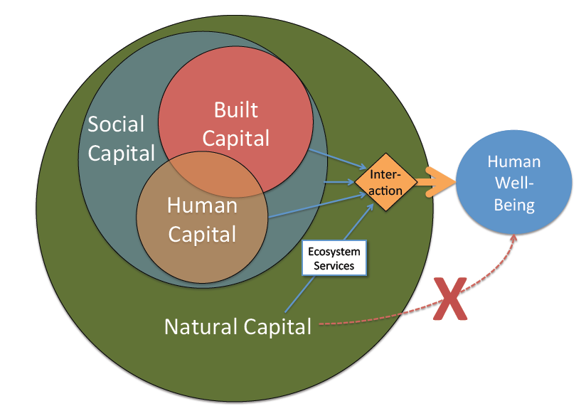
Ecological Economics Paradigm
Interaction between built, social, human, and natural capital required to produce human well-being. Built and human capital (the economy) are embedded in society which is embedded in the rest of nature.
Ecosystem services are the relative contribution of natural capital to human well-being, they do not flow directly. It is therefore essential to adopt a broad, transdisciplinary perspective in order to address ecosystem services.
Examples:
Snorkels and coral reefs
Skiing equipment and Ski resorts
NOTE: Built and Natural Capital are not 100% Substitutable

Slide 27
A Tale of Two Paradigms
Neo-Classical
Economics
Ecological
Economics
The purpose of an economic system is to maximize Gross Domestic Product (GDP or GDP/Capita) regardless of how wealth is distributed.
The purpose of an economic system is to maximize human
well-being which results from an interaction of social, built, natural, and human capital
Not everything that can be counted counts,
and not everything that counts can be counted.
Albert Einstein
27

Slide 28
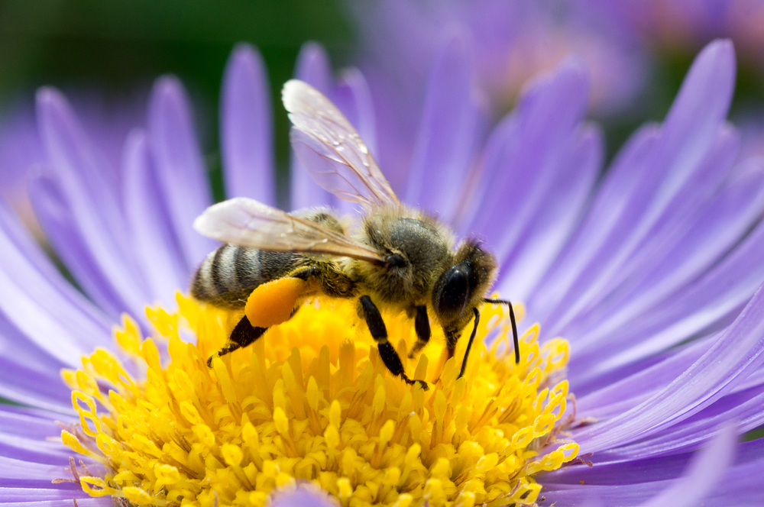
Free Markets willnot:
An Ecosystem Service Elevator Story
To help us all communicate better . . .?
Pollination
Bee pollination is an
Ecosystem service that is
Vital to agriculture and
Other wildlife. There are many ways to estimate the
Economic value to humans that comes from this ecosystem service.
Valuing Insect Pollination Services with Cost of Replacement
http://www.plosone.org/article/info%3Adoi%2F10.1371%2Fjournal.pone.0003128

Slide 29


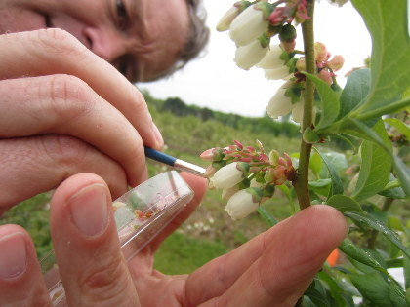
The Dollar Cost to replace bee pollination services would be Significant and Essential
Doing crop
pollination by hand
would cost over
$200 Billion
per year for food
crops alone.

Slide 30
What’s Wrong With The
Neo-Classical Economic Paradigm?
An Economist could propose the following
‘Final Solution’:
KILL ALL THE BEES!
WHY?

Slide 31
BEE EXTINCTION is a ‘Win’ – ‘Win’ – ‘Win’ triple bottom line economic policy.
Win #1: It Creates Jobs!
Win #2: It increases GDP!
Win #3: It generates Tax Revenue!
“Really, it’s nothing personal against the bees it just makes economic sense to exterminate them.”
BTW: War and Hurricanes are
Good for the economy too.

Slide 32
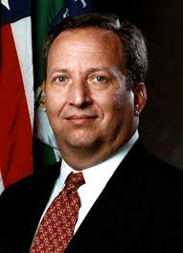
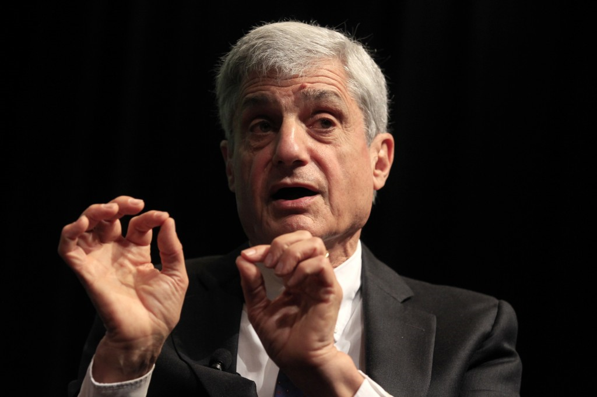
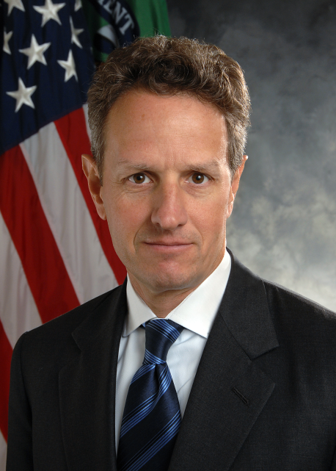
Is the prevailing economic world view working for us?
Who are President Obama’s Key Advisors?
Robert Rubin
Larry Summers
Tim Geithner
Name ONE ‘Environmental’ advisor to Obama that has one tenth the
influence or power of any one of these three economic advisors.
REMEMBER THIS: Ecosystem Services are valued at roughly
TWICE the world’s Market Economy.
Since 1997 we’ve lost roughly ~$20 Trillion/year
That is not good management in ANY world view.

Slide 33
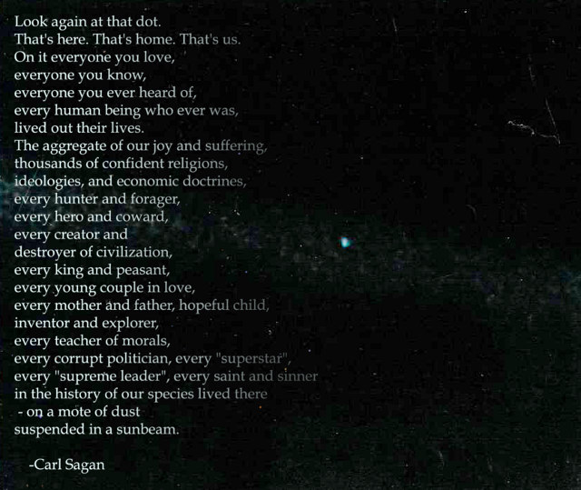
The Pale Blue Dot
Thank
You
Questions
or
Comments ?
33

