Slide 1
Developing Course and Program level ‘Learning Outcome’ metrics for a University Geography Department
Paul C. Sutton
Department of Geography
University of Denver
psutton@du.edu

Slide 2
Outline
Confessions of an ‘Anti-Assessment’ curmudgeon
Reasons for my Apostasy
Motivation for development of METRICS to measure outcomes
Limitations of Course Evaluations as a measure of ‘Learning’
Hierarchy of ‘Learning Outcomes’
Existing Learning Outcomes
What to measure?: ‘General Skills’ or ‘Geography Skills’
A ‘Geographic Concept Inventory’ ?
Some sample questions (modest proposals)…
Feedback

Slide 3
Why I have been an ‘anti-assessment’ Curmudgeon
My experience with program assessment and measurement of ‘learning outcomes’ has been characterized as a last minute activity that is usually driven by some external force such as an accreditation team visiting the university or an external departmental review.
Typically this burden falls on the chair of the department who is not really ecstatic about another temporal vortex of doom.
The strategy for responding to these external forces typically is minimal satisficing behavior. Hard work and honest effort are more likely to be deemed inadequate than politically and institutionally savvy pablum (e.g. “fill out the matrix” & “No good deed will go unpunished”)
I’ve always believed that my exams and other instruments used in my courses measured ‘learning outcomes’ quite well.

Slide 4
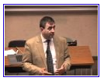
My experiences on the ‘road to Damascus’
A Sigma Xi talk at Du presented by
Eric Mazur (Physics Prof at Harvard) on ‘The Force Concept Inventory”
Mazur wins teaching awards,
gets great course evals and students
perform well on hard exams; yet…..
They don’t really understand the basics
of Newton’s three laws.
The Book: Academically Adrift by
Richard Arum & Josipa Roksa.
CLA instrument shows NO change in ~40% of
student abilities in areas of critical thinking,
complex reasoning and writing - after 2 yrs of
College.
The PBS show: Declining by Degrees
Tracks students at various colleges.
Many seem to be graduating with
3.5 GPAs while not studying much
and learning even less.
http://www.youtube.com/watch?v=WwslBPj8GgI

Slide 5
Motivations for Development of Metrics of ‘Learning Outcomes’
Panel Session 2148 & 2248: Making the Case for Geography
Communicating the value of Geography to various audiences
External Accreditation
Demonstrating program rigor and effectiveness to outside world
Demonstrate value of Geography internally to the University
Why do we attract students and what benefits do they gain?
My own evolving curiosity about what I’ve been doing for 20 years.
Evaluation of Teaching Effectiveness & Course Evaluations
A DU geography faculty member recently denied tenure based primarily on course evaluations.
How good are course evaluations for assessing classroom effectiveness?

Slide 6
Course Evaluations are not the be all end all of ‘Learning Outcomes’ measurement
A study of course evaluations in Geography At DU
N = 285 Undergrad Courses taught by 18 faculty (6 women & 12 men)
Anonymous ‘End of Quarter’ course evaluations
LIC_Avg is average of the 1-6 Likert response to questions:
I learned a great deal in this course
Overall, this is an effective instructor.
Overall, this is an excellent course.
Course Type Categorized as follows:
‘R’ - for Regular Geography classes
‘M’ - for Core Curriculum classes (larger with many non-majors)
‘FSEM’ - for First Year Seminar
‘F’ – for Field Quarter classes or classes Taught Abroad
‘C’ – for computationally intensive classes
‘B’ – for ‘BIG’ introductory classes (~50-150 students)

Slide 7
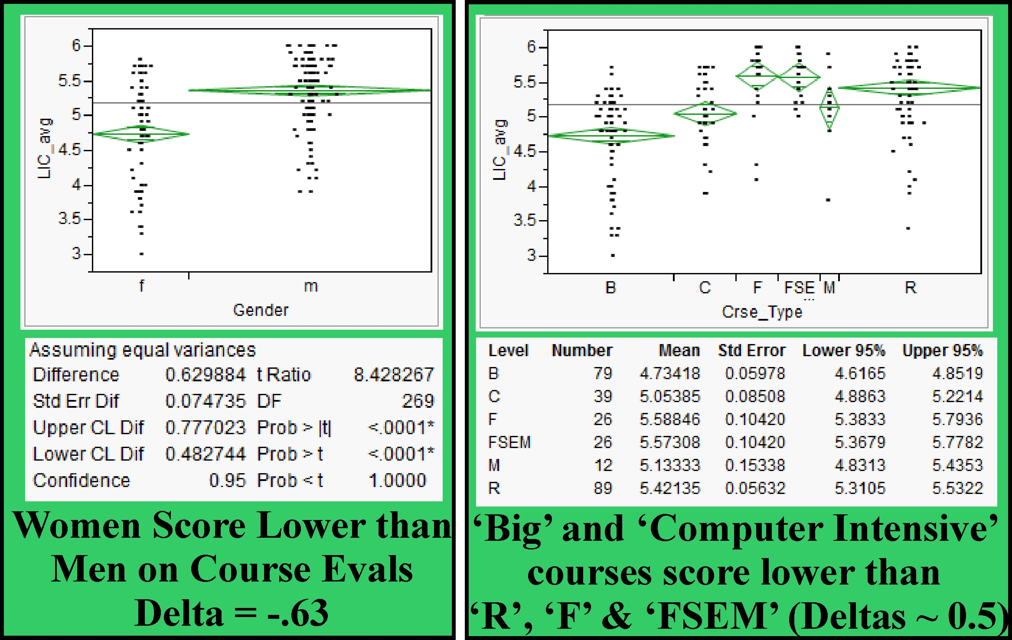
Course Evals by ‘Gender’ & ‘Course Type’

Slide 8
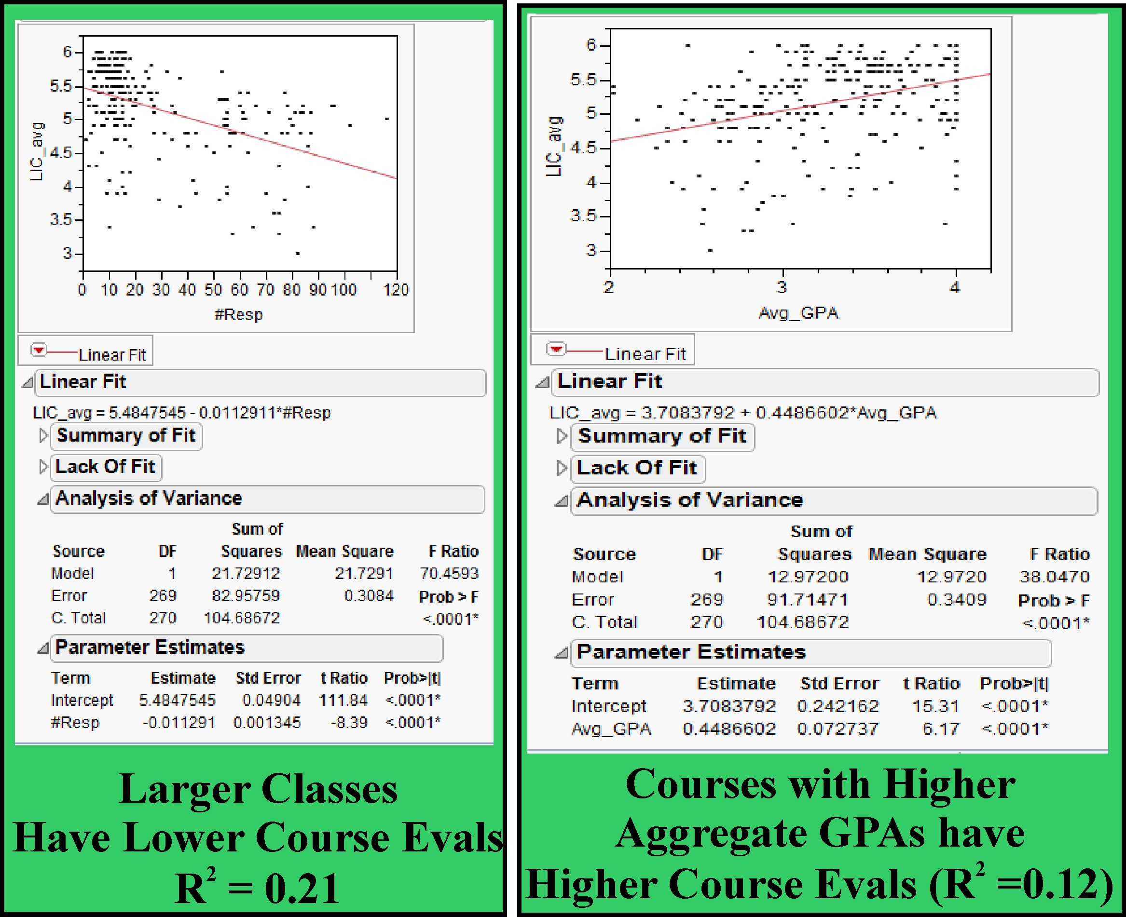
Course Evals by GPA and Class Size

Slide 9
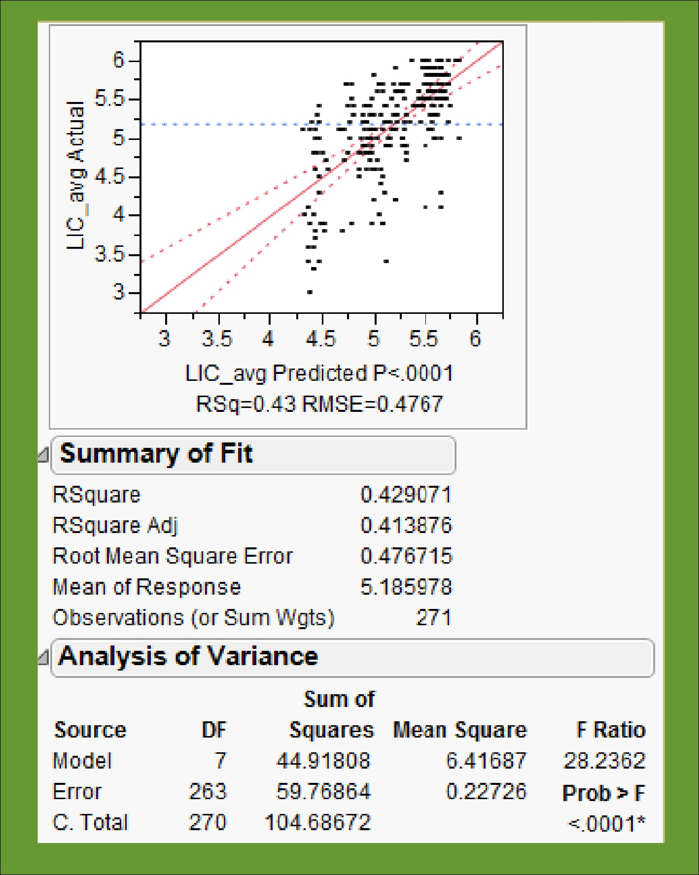
43% of Course Evaluation Variation explained by Gender, Course Type, and GPA
Simple Multiple Regression model predicting LIC_avg using: Gender, Avg GPA of course, and Course Type predicts 43% of variation in composite course evaluation scores.
In light of these results it seems inappropriate to put too much weight on Course Evaluations as measures of classroom effectiveness and/or learning outcomes.

Slide 10
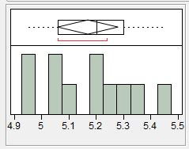
Overall Variation in LIC_avg
Overall variation in the LIC_avg metric when corrected for effects of ‘Gender’, ‘Class Size’, and ‘Aggregate GPA of course’ for the average of all tenure track faculty course evaluation scores in Geography at the University of Denver varies from 4.95 to 5.45
The overall department mean was 5.19
One faculty member (5.45) was significantly above the mean. (p = .05)
Two faculty members (4.95) were significantly below the mean. (p = .05)
The ‘Gender Differential’ is greater than overall variation in Faculty means
Question: In light of the meaning of the questions on the course evaluation instrument is there enough variation here to say anything useful about how effective these instructors are? (we are all 5’s after all)

Slide 11
A Hierarchy of ‘Learning Outcomes’
The University level –
What good is a Bachelor’s degree?
Things like: Critical thinking, Quantitative reasoning, rhetoric, logic etc. ???
The Collegiate Learning Assessment (CLA) / National Survey of Student Engagement (NSSE)
The Department or Program Level –
What good is a Geography degree?
Things like: Ability to ask and answer questions that mandate the acquisition, representation, and analysis of spatially referenced data. More than basic knowledge of physical and human geography facts, concepts, and processes. ???
The Individual Course level –
What good is Intro to GIS, Physical Geography, etc.?
Things like: The questions we pose on our exams and assignments. ???

Slide 12
Goals & Learning Outcomes in a Geography Program (these are taken from Geography at Cal State Sacramento)
1. Demonstrate a knowledge of the basic concepts of physical and human geography;
2. Have an understanding of the nature of Geography as an academic discipline, including
familiarity with its history and principal subfields;
3. Demonstrate a competency in selected geographic techniques;
4. Display competency in the graphic expression of geographic/spatial data (maps,
photographs, graphs, data bases);
5. Display competency in written expression with respect to clarity, logical expression, and effective argument;
6. Understand and apply the basic research skills, including the ability to (a) critically
evaluate the research of others and (b) effectively design a research project on one’s own.
7. Acquire knowledge and skills sufficient to allow one to pursue advanced study in
geography or find employment in geography-related field.
Learning Outcomes: A variety of learning outcomes are identified to help the student
Achieve the above goals and they reflect the different levels of learning set forth in Bloom’s taxonomy
including basic knowledge and comprehension, application, analysis and evaluation, and synthesis

Slide 13
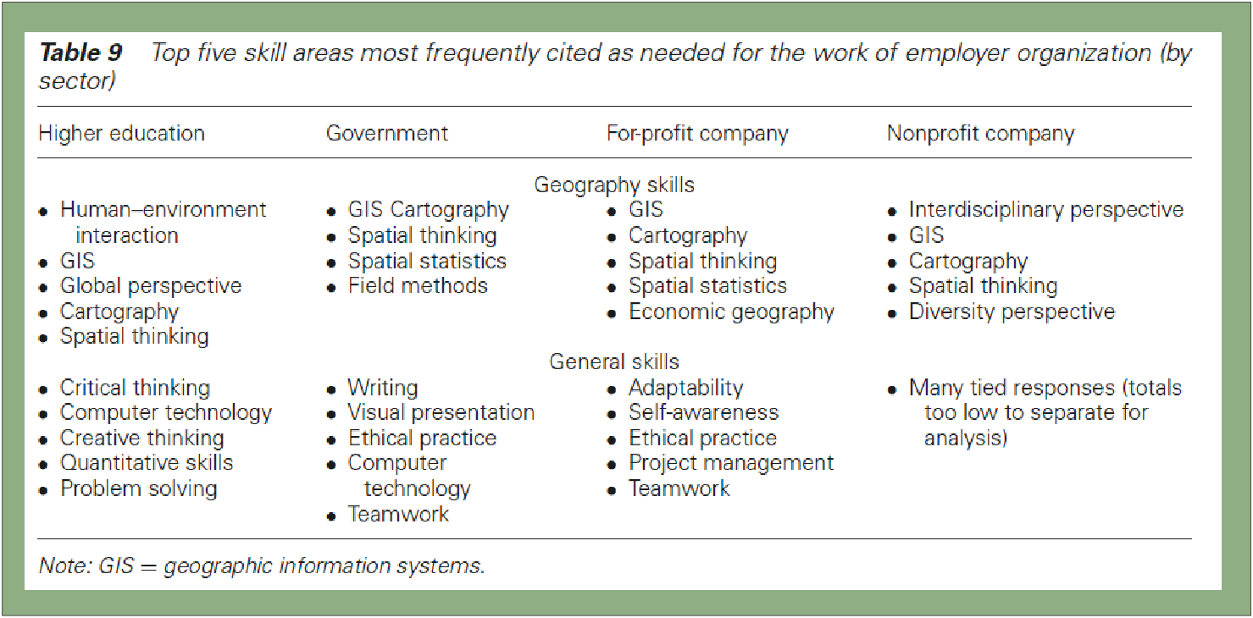
Skills in Professional Geography: An Assessment of Workforce Needs and Expectations (Paper in the PG)
Solem, Michael , Cheung, Ivan and Schlemper, M. Beth(2008) 'Skills in Professional Geography: An
Assessment of Workforce Needs and Expectations', The Professional Geographer, 60: 3, 356 — 373

Slide 14
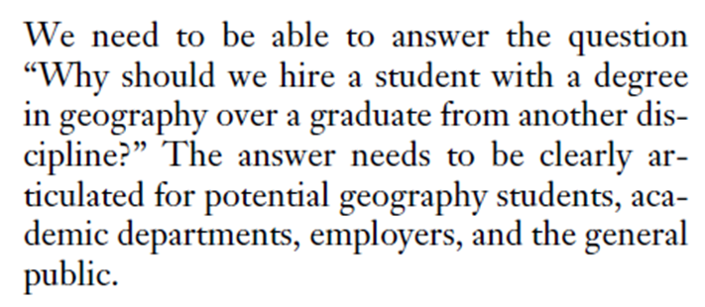
What are Program responsibilities in terms of delivering and measuring learning outcomes?
Computer Skills?
Effective written and oral communications?
Spatial Thinking?
Ethical Practice?
Teamwork?
Cartography?
(Quote above taken from Solem et al.
Professional Geographer 2008)
While Geography Departments and programs contribute to the development
Of ‘General Skills’ such as ‘Teamwork’ , ‘Critical Thinking’, etc. I would argue that
Our programmatic ‘Learning Outcome’ measurements focus more on ‘Geography
Skills’ such as Field Methods, GIS, Spatial Thinking, etc. Because they answer the
Question – “Why hire a student with a degree in Geography?”

Slide 15
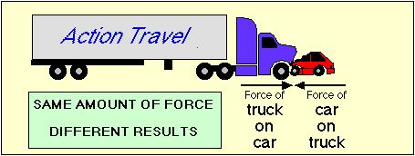
The Force Concept Inventory and, … How do we measure ability to “Reason Spatially”?
Is the force of big
truck on the little car……
Bigger
Smaller
The Same
As the force of the little car on the big truck?
Even students that do well in Physics get some of these basic
Conceptual questions wrong.
Do Geography students have these kinds of Problems?
(Cal State Sacramento Program assessment suggests maybe)
Is Geography analogous to Physics in this sense?
(Did Albert Einstein think Geography was too hard ?☺)

Slide 16
The apocryphal Harvard Grad Question (perhaps this makes this question a good candidate for a ‘Geographic Concept Inventory’)
When posed with this classical physical geography question,
graduates of Harvard University performed no better than
nearby 9th grade students.
Question:
“Why is it warmer in the summer than it is in the
winter in the United States?”
Because the earth is closer to the sun during the summer
Because the gulf stream heats the northern hemisphere in the summer
Because the North Pole is tilted toward the sun in summer
Because the Moon blocks a lot of sunlight during winter months
It’s not really warmer, it only seems that way because the days are longer
http://news.harvard.edu/gazette/1997/05.29/VideoRevelation.html

Slide 17
What would questions that constitute a ‘Geographic Concept Inventory’ look like?
1) Good students that did not take Geography classes should do poorly on them.
2) Good Geography students should do very well on them.
3) All Geography graduates should do fairly well on them (at least better than smart non-geography students)
4) They should not be trivial pursuit questions.
5) Some of the questions should tie back to specific courses so they can be used for evaluating classroom effectiveness or ‘learning outcomes’ for specific faculty (a supplement to course evaluations)
6) Questions should not be too difficult to administer or grade.
7) The suite of questions should cover the breadth of geography and the instrument should be transportable from one institution to another.

Slide 18
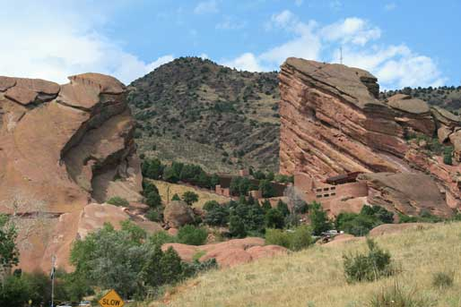
Some Modest proposals……
Question 1: Spatial Thinking and Remote Sensing:
The famous “Red Rocks” amphitheater outside of Denver, CO consists of massive sandstone outcrops on the foothills of the eastern side of the rocky mountains. Under what lighting conditions will these rocks appear most RED?
A) At Sunset on a cloudless day
B) At Sunrise on a cloudless day
C) At local noon on a cloudless day
D) Any time of day on a cloudy day
E) They always have the same ‘Redness’

Slide 19
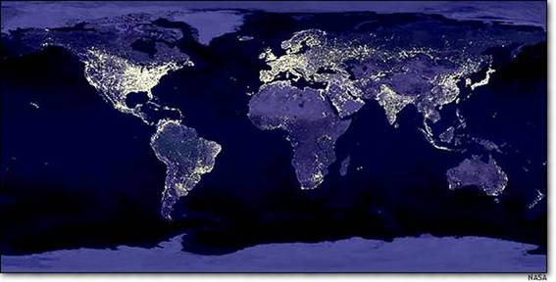
Modest Proposals continued ….
Question 2: Basic Demographic Facts
What is the 3rd most populous nation of the world?
A) China
B) India
C) Indonesia
D) The United States
E) Russia
Is this a trivial pursuit question?

Slide 20
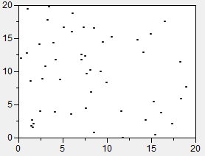
Modest Proposals continued….
Question 3: Spatial Analysis and Representation
Consider the idea of Complete Spatial Randomness (CSR) for a point pattern. If you wanted to generate a spatially random pattern of points in a Cartesian plane you would best use a ________ probability density function (pdf) for the ‘X’ coordinates and a ___________ pdf for the ‘Y’ coordinates.
Normal, Normal
Binomial, Binomial
Uniform, Uniform
Poisson, Normal
Normal, Poisson

Slide 21
Discussion Questions / Feedback
How mandatory is multiple choice?
Are satellite and software specific questions out of bounds?
(e.g. questions with words and acronyms like: Landsat, ESRI, TIGER, shapefile)
Is it reasonable to use student performance on these questions as a supplement to course evaluations for evaluating teaching effectiveness of individual faculty?
Do you think it is likely we could develop an instrument that Geography students would do well on but good students who do not take Geography courses would not do well on?
Should there be a ‘practical’ element to any attempt to measure program level learning outcomes (e.g. make a map, formulate and answer a geographic question etc.)
Send me your suggested questions for a Geographic Concept Inventory: psutton@du.edu ☺

Slide 22
Learning Outcomes at DU Geography http://www.du.edu/assessment/docs/slos/geography.html
Undergraduate Student Learning Outcomes
The Department identified the following student learning outcomes for its geography programs:
Identify and analyze the spatial aspects of natural environmental systems and human activities.
Explain basic geographic themes such as location, place, human/environment interaction, movement, and region, and apply them in illustrating similarities and differences in human and physical environments.
Demonstrate ability in the tools and techniques of physical geography, human geography, spatial analysis, and geographic information science, including basic field, laboratory, cartographic and statistical skills.
Demonstrate effective communication skills through written, verbal, visual, and technologically mediated representations.
Critically examine geographical problems and use scientific methodology and spatial analysis to propose and advocate potential solutions.
Most of our ‘Measurement’ of these learning outcomes is through performance in individual courses. We do not have a well developed metric for measuring these learning outcomes at the Department or Program level.

